Slide 1
Understanding CSS Essentials: Layouts
3.2. Arrange user interface (UI) content by using CSS.

Slide 2
Agenda
1
The User Interface
2
The CSS Box Model
3
The Flexbox Box Model
4
Grid Layouts

Slide 3
The User Interface

Slide 4
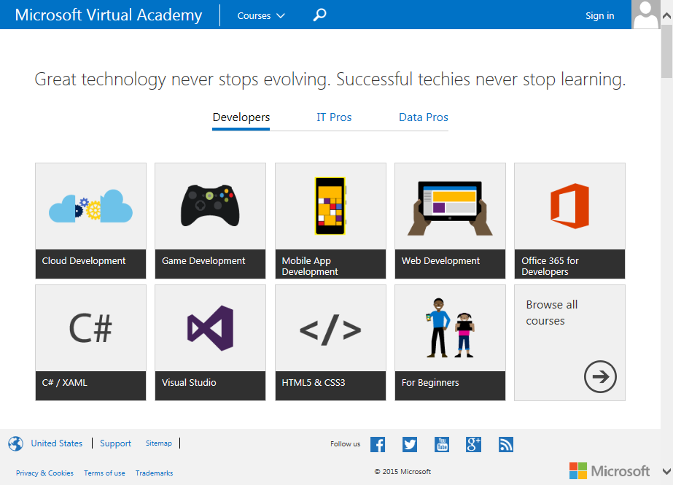
The User Interface (UI)
The portion of a Web page where users interact is called the user interface (UI)
The layout of a user interface will dramatically impact a user experience
layouts can range from minimalist with just a few elements, to pages that are jammed full with content
Simple layouts and complex layouts require different models to ensure that content displays properly for users

Slide 5
Vendor Prefixes
As with HTML5, CSS3 is still in a draft format and might not be compatible with all browsers
New properties are being added all the time, while others are being modified
Many browsers offer alternative property names to workaround any compatibility problems
These property names must be used in conjunction with a vendor prefix
A vendor prefix is simply a keyword that is surrounded by dashes
Check out the chart for examples
WEB BROWSER | PREFIX
Internet Explorer | -ms-
Firefox | -moz-
Opera | -o-
Chrome | -webkit-
Safari | -webkit-

Slide 6
Vendor Prefixes in Action
To apply the flexbox style to elements in a browser, like Chrome, you simply add the -webkit-flexbox property to your CSS
A best practice is to include the property with all four vendor prefixes
This will increase the likelihood that your Web page will render correctly
If you have questions about whether your property will display properly, then check out caniuse.com

Slide 7
The CSS Box Model

Slide 8
The CSS Box Model, pt. 1
The CSS Box model defines the rules for how content is formatted on a Web page or Web application
Each element of HTML is in a box that multiple components, including padding, border, and margin
Padding is the space between the content and its border
Border surrounds the box that content sits inside
A margin is the space that surrounds the box and sits between other boxes in a Web document
Margin
Border
Padding
Content

Slide 9
Block-level and Inline Elements
Within the CSS Box model, there are two categories of elements
block-level
inline
Block-level elements create boxes that are a part of a pages layout
this category includes articles, sections, paragraphs, headers, footers and more
Inline elements are used to format content
this category includes emphasis and boldface
BLOCK LEVEL ELEMENT EXAMPLES
<div> <p> <ul>, <ol>, <dl> <h1> - <h6> <form>
INLINE ELEMENT EXAMPLES
<img/> <a> <strong> <em> <input>

Slide 10
Parent/Child Relationship
With the CSS Box model, it is possible for a box to contain one or more boxes
The outer box is referred to as the parent
An inner box is referred to as a child
This is similar to nesting tags in HTML
A child inherits CSS styles from a parent, which means that styles applied to a parent will apply to a child as well
This isn’t the case for all CSS properties
Parent Box
Child Box

Slide 11
Problems with the CSS Box Model
The CSS Box model is not without problems
Some browsers will apply properties differently
For example, height and width are supposed to be separate attributes but sometimes aren’t treated as such by older browsers

Slide 12
Flexboxes

Slide 13
The CSS Flexbox Box Model
CSS3 now includes the Flexbox Box model, a layout mode that provides flexibility when a user changes the size of their browser window
Elements, navigation bars, forms and pictures will resize and reposition automatically to fill available space
We use media queries to determine which device is being used
CSS uses this information to automatically adjusts our HTML document to fit a screen

Slide 14
Flexbox Items
An element is defined as a flexbox using the display property
The display property possesses two values: flexbox and inline-flexbox
the flexbox value sets the flexbox as a block-level element
the inline-flexbox value sets the flexbox as an inline-level element

Slide 15
Flexbox Properties and Values, pt. 1
Flexbox introduces nine other properties, each with their own set of unique values
PROPERTY | VALUE(S) | DESCRIPTION
flex | pos-flex neg-flex preferred-size none | Makes child boxes flexible by height and width
flex-align | start end center baseline stretch | Sets the default alignment for child boxes; if the orientation of the parent box is horizontal, flex-align determines the vertical alignment of the child boxes and vice versa

Slide 16
Flexbox Properties and Values, pt. 2
PROPERTY | VALUE(S) | DESCRIPTION
flex-direction | row row-reverse column column-reverse | Controls the direction of child boxes in the parent box; also affects the flex-pack property
flex-flow | flex-direction flex-wrap | Sets the flex-direction and flex-wrap properties at the same time
flex-item-align | auto start end center baseline stretch | Overrides the default alignment of child boxes styled with the flex-align property

Slide 17
Flexbox Properties and Values, pt. 3
PROPERTY | VALUE(S) | DESCRIPTION
flex-line-pack | start end center justify distribute stretch | Sets child box alignment within the parent box when extra space exists
flex-order | number | Assigns child boxes to groups and controls the order in which they appear in a layout, beginning with the lowest numbered group
flex-pack | start end center | Justifies the alignment of child boxes within a flexbox to ensure all whitespace in the parent box is filled
flex-wrap | nowrap wrap wrap-reverse | Determines whether child boxes automatically create a new line and wrap onto it or overflow the flexbox

Slide 18
Working with Flexboxes
Flexboxes can contain other boxes, or child boxes, which are referred to as flexbox items
With the flex property, you can make the flexbox items flexible as well
recall that the display property is used to make parent boxes flexible
The flex property can be used to proportionally scale flexbox items when the flexbox increases or decreases in size
Parent
Child 1
Child 2
Child 3
Parent
Child 1
Child 2
Child 3

Slide 19
Changing the Direction of Child Items
The flex-direction property allows developers to change the direction of child boxes in a flexbox
it uses the row, row-reverse, column, and column-reverse values
The flex-wrap property determines if child boxes will wrap onto a new line when a window condenses
it uses the nowrap, wrap, and wrap-reverse values
The flex-flow property sets the flex-direction and flex-wrap properties at the same time
Parent
Child 3
Child 2
Child 1
Parent
Child 1
Child 2
Child 3

Slide 20
Flexbox Demo
<style type="text/css">
#myFlexbox {
display: -ms-flexbox;
-ms-flex-direction: row | row-reverse | column | column-reverse;
-ms-flex-wrap: wrap;
background: gray;
height: auto;
}
#childBlue {
background: blue;
height: 80px;
width: 100px;
}
#childGreen {
background: green;
height: 80px;
width: 100px;
}
</style>
Notes:
https://msdn.microsoft.com/en-us/library/hh673531(v=vs.85).aspx

Slide 21
Ordering and Arranging Content
The flex-order property allows you to adjust the order and arrangement of contents inside of a flexbox
The property groups child boxes to control the order in which they appear in a layout
The default value for the flex-order property is 0
Parent
Apple
Orange
Pear
Parent
Orange
Apple
Pear

Slide 22
More About Flexboxes
https://msdn.microsoft.com/en-us/library/hh673531(v=vs.85).aspx
Notes:
https://msdn.microsoft.com/en-us/library/hh673531(v=vs.85).aspx

Slide 23
Grid Layouts

Slide 24
The Grid Layout Model
When the Flexbox Box model isn’t appropriate, you can use the Grid Layout model
The Grid Layout model uses CSS to structure content using rows and columns
Grids are extremely flexible and provide an easier to use option for organizing content than HTML tables
<header>
<aside>
<section>
<section>
<section>
<section>
<section>
<footer>

Slide 25
Grid layouts and Grid Items
Grid layouts are very similar to tables because they feature rows and columns
They are best suited for more complex layouts – like those required by newspapers – than flexboxes can handle
The content in grid layouts are also modular, which allows you to move content from one part of the page to another
masthead
nav
column 1
column
2
column
3
footer

Slide 26
Defining the Grid Layout
Define a grid layout by using the display property, along with the grid or inline-grid values
Child elements in a grid are called grid items, which can be positioned according to grid tracks, grid lines, or grid cells
LAYOUT CONCEPT | DESCRIPTION
Grid tracks | The columns and rows of a grid
Grid lines | The horizontal and vertical lines that separate columns and rows
Grid cells | The logical space where content is placed

Slide 27
Grid Properties and Values, pt. 1
PROPERTY | VALUE(S) | DESCRIPTION
grid-columns or grid-rows | length percentage fraction max-content min-content minmax(min,max) auto | Specifies parameters for one or more columns or rows in a grid
grid-template | string+ none | Provides a visualization of the grid element’s structure and defines the grid cells
grid-cell | string none | Positions a child item inside a named grid cell

Slide 28
Grid Properties and Values, pt. 1
PROPERTY | VALUE(S) | DESCRIPTION
grid-column or grid row | [integer or string start] [integer or string end] auto | Places child items in a grid
grid-column-span or grid-row-span | integer | Defines the dimensions of a grid cell by specifying the distance (in lines) from the string line to the ending line
grid-column-sizing or grid-row-sizing | none rows columns | Creates additional columns or rows as needed to accommodate content
grid-column-align or grid-row-align | start end center stretch | Controls a child item’s alignment within a cell

Slide 29
Grid Layout Demo
<style>
#gridded {
display: -ms-grid;
background: gray;
-ms-grid-columns: 10px 250px 10px 250px 10px 250px 10px 250px 10px;
-ms-grid-rows: 1fr;
}
#item1 {
background: orange;
-ms-grid-row: 1;
-ms-grid-column: 1;
}
#item2 {
background: purple;
-ms-grid-row: 2;
-ms-grid-column: 2;
}
</style>
Notes:
https://msdn.microsoft.com/en-us/library/hh673531(v=vs.85).aspx

Slide 30
More About Grid Layouts
https://msdn.microsoft.com/en-us/library/hh673533(v=vs.85).aspx

Slide 31
Summary
1
The User Interface
2
The CSS Box Model
3
The Flexbox Box Model
4
Grid Layouts

Slide 33
Notes (hidden)
Some speakers at Microsoft like to use this slide for hidden “notes slides”.
Delete it if you don’t want to use it.
NEXT: <next slide title>

